Slide 1
Eddie Robertson – WYDAC Chairperson

Slide 2
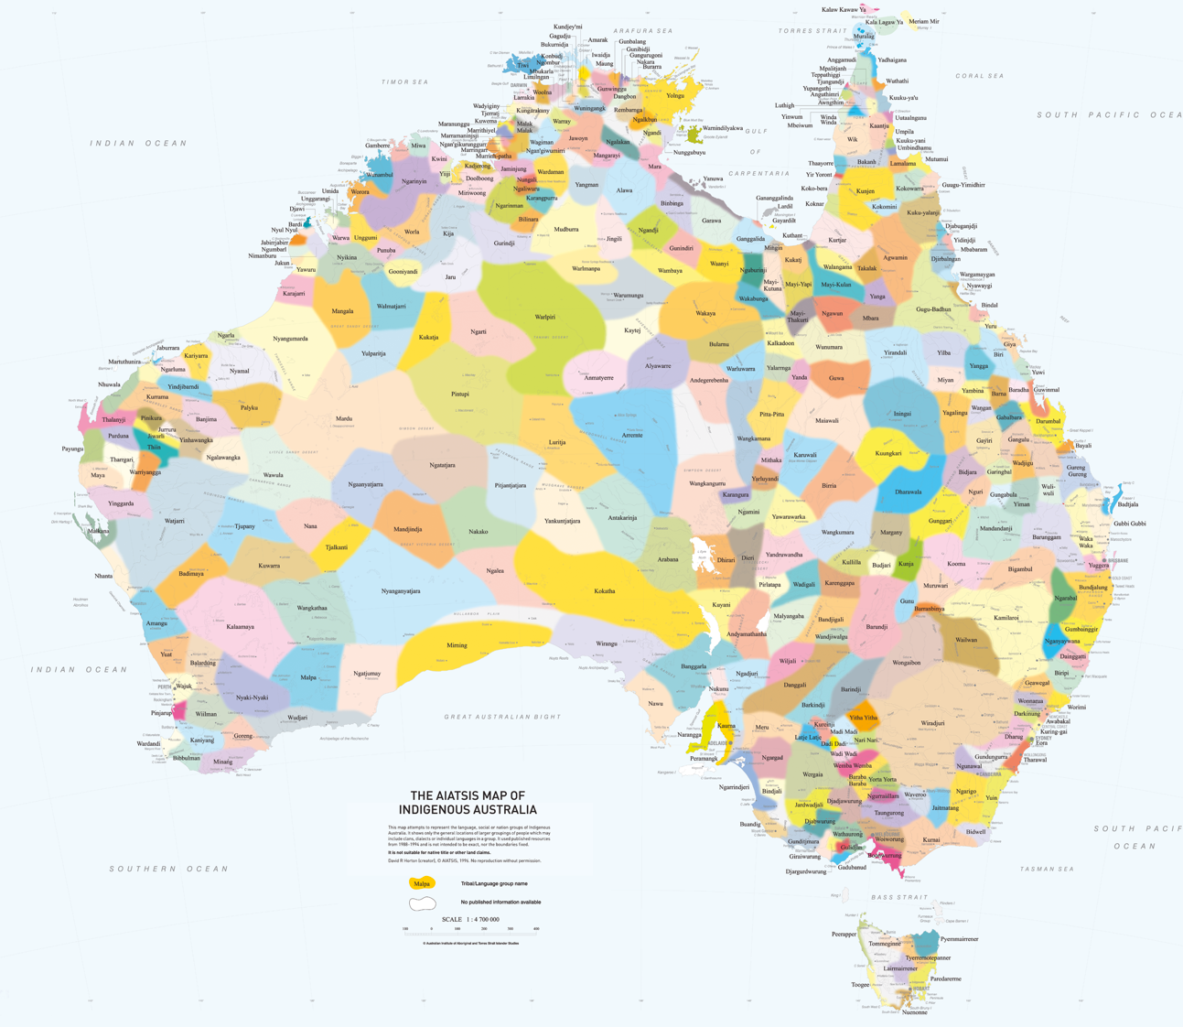
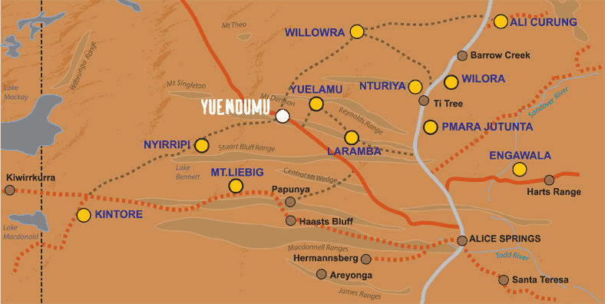
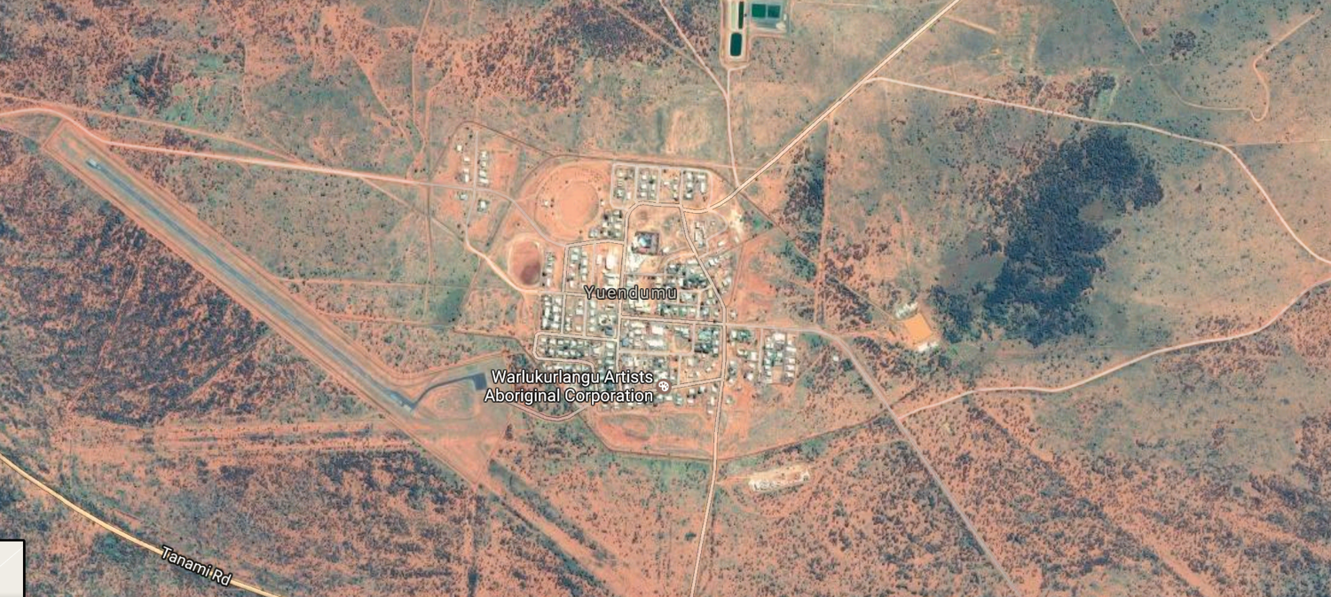
Warlpiri Ngurra (Country)
Notes:
Do a zoom in
Eddie video
Max speaking

Slide 3
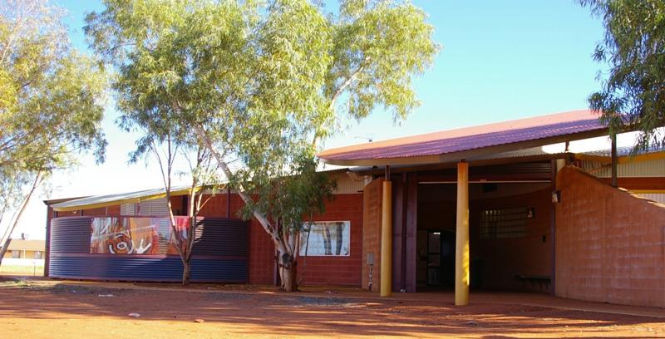
Warlpiri Youth Development Aboriginal Corporation
(WYDAC)
Notes:
max

Slide 4
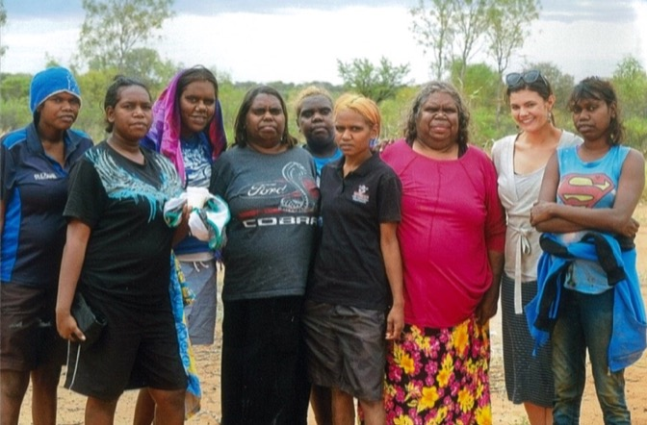
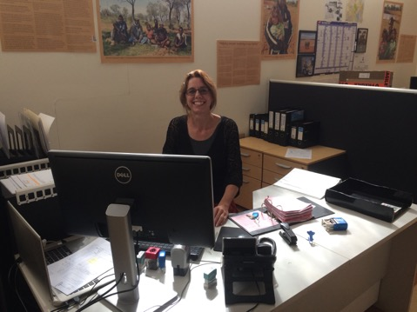
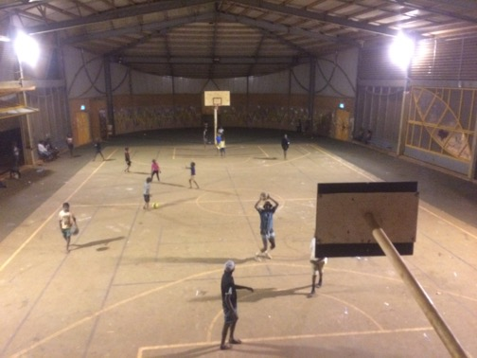
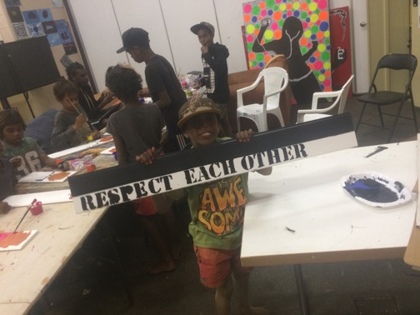
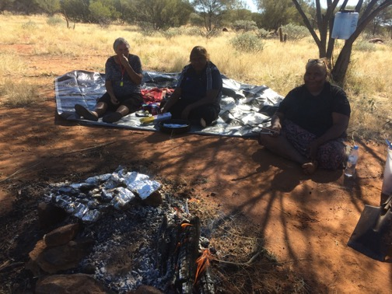
Office
Warri Warri Kanyi Counselling
Youth Program Hall
Activities Room
Bush Trips
Notes:
Max
Lisha hold photo up

Slide 5
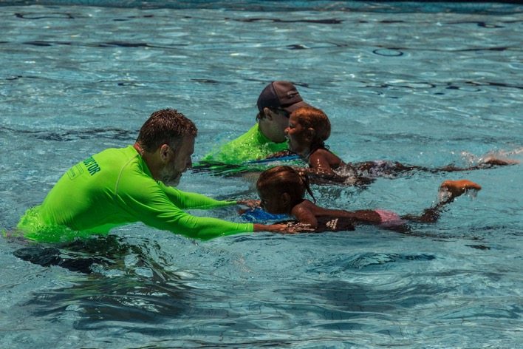
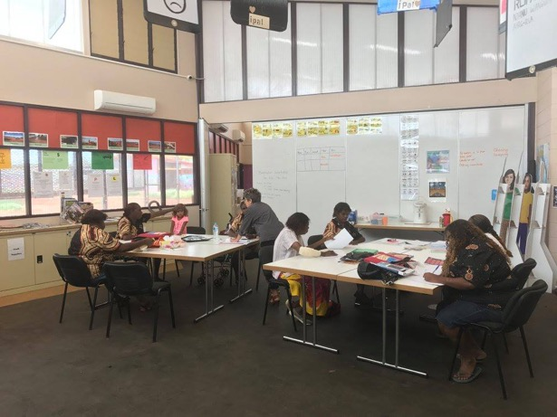
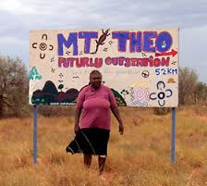
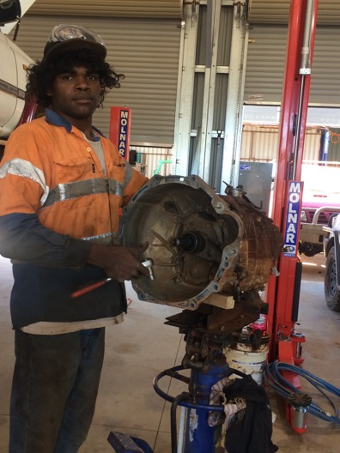
Yuendumu Pool
Pina Pina Jarrinjaku Learning Centre
Mt Theo Outstation (Cultural Rehabilitation)
Mechanics Workshop

Slide 6
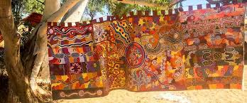
Jaru Pirrjirdi
(Strong Voices) Program

Slide 7
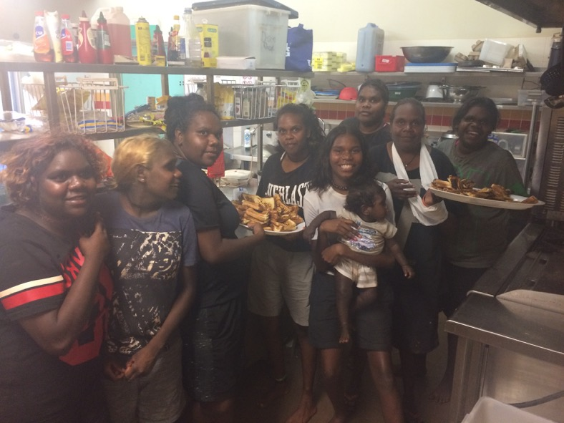
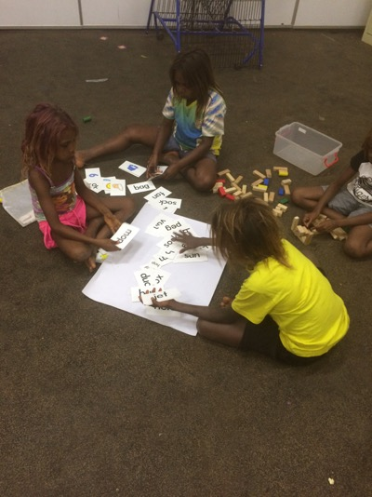
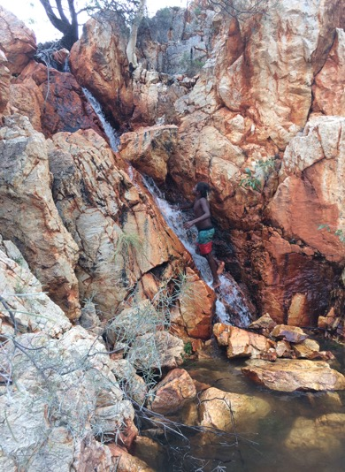
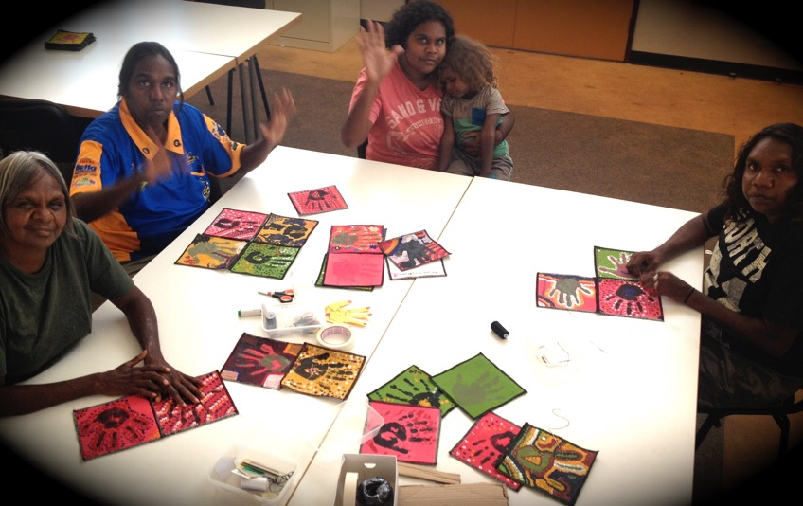
Diversionary
Meaningful activities
Positive pathways
Notes:
kirsten

Slide 8
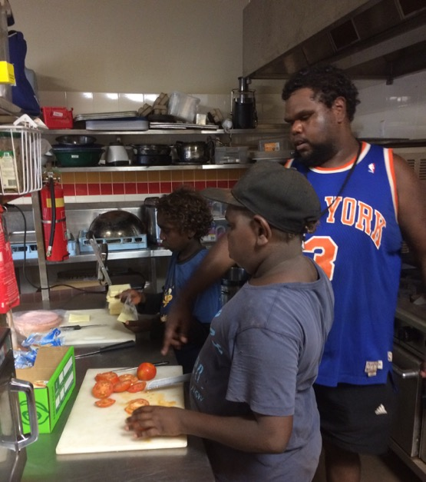
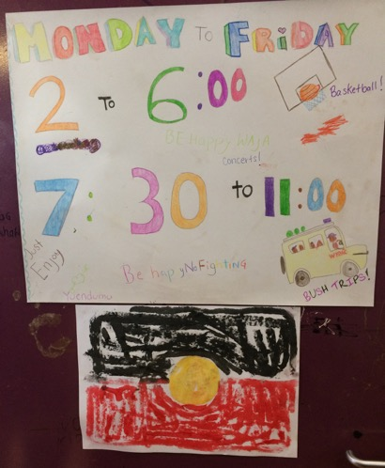
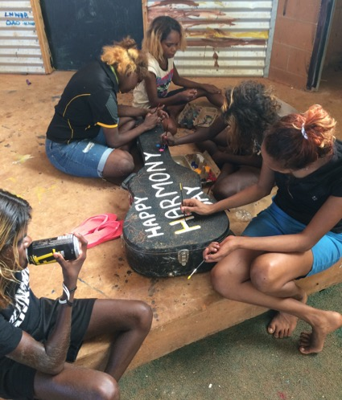
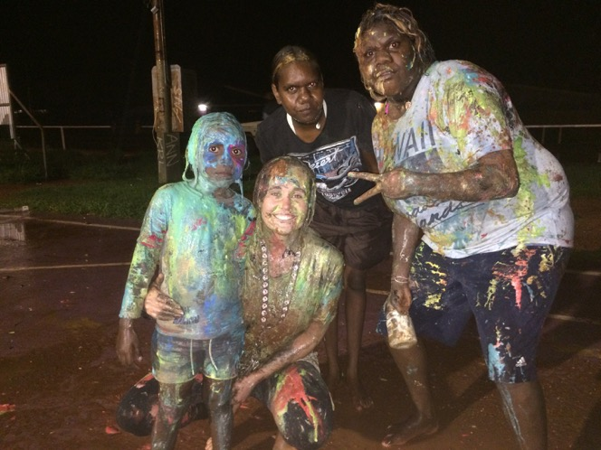
Employment
Skills development
Casual and flexible
Opportunities in all services
Notes:
max

Slide 9
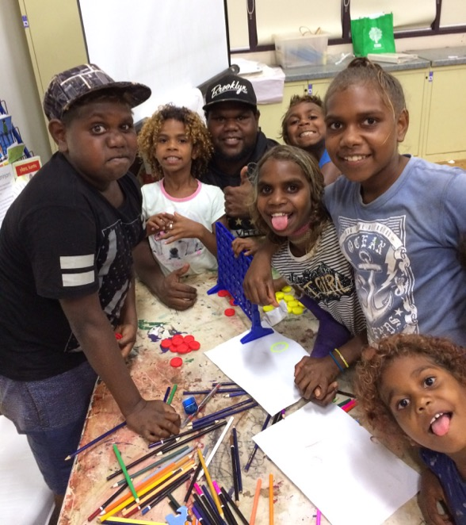
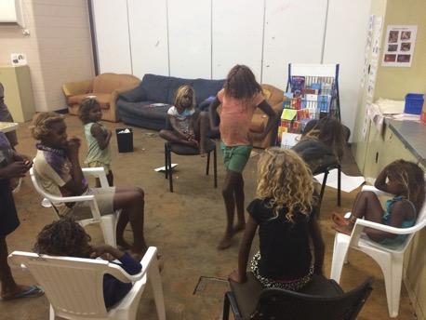
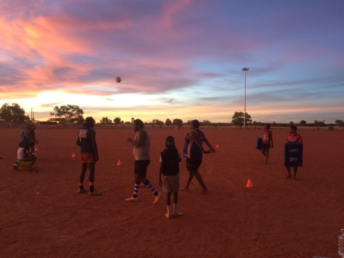
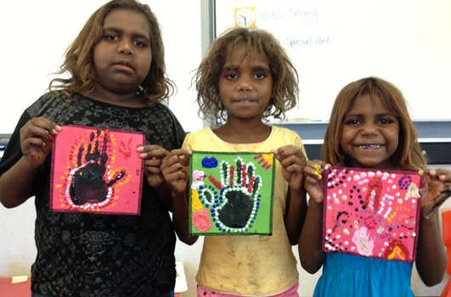
Leadership
Role model
Responsibility
Yapa (Warlpiri People) way
Notes:
kirsten

Slide 10
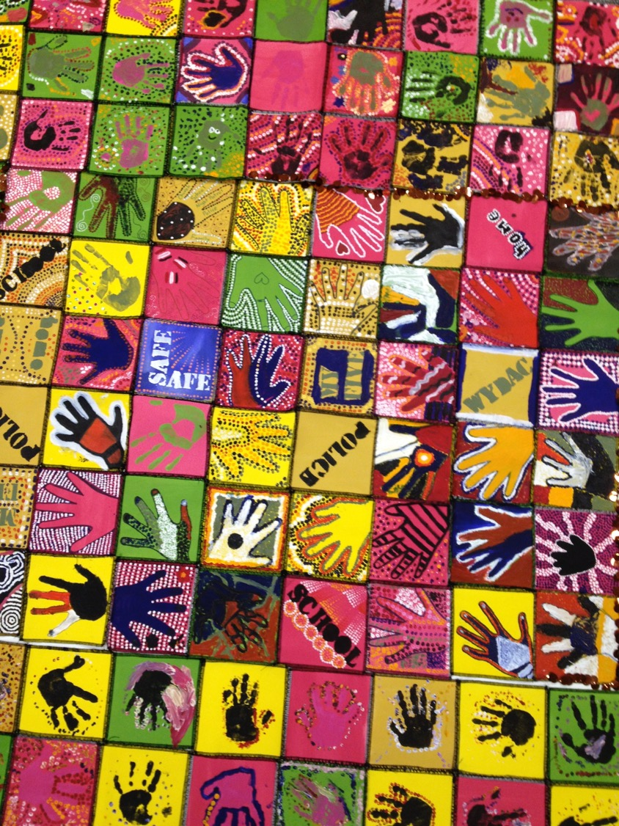
Notes:
max

Slide 11
Thanks for having us Darwin!

